Slide 1


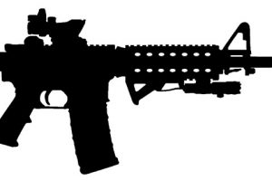

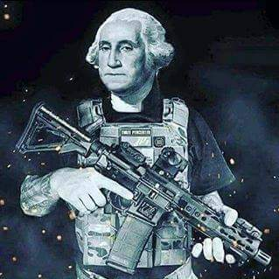

 | Hell Yes, We’re Going to Take Your PCCs! Course Designer: Kris Erickson |  |  |  |  | Bay 3
SCENARIO: In the near dystopian future, President O'Rourke's flack vested gun buyback brigade has come knocking at your door. Boogaloo time!
START POSITION: Standing at door. Pistol loaded to division capacity and holstered, hands naturally at sides. PCC START: Standing at door, rifle at low ready. |  | STRINGS | CONCEALMENT |  | SCORING |  | TOTAL ROUNDS
 |  | 1 | REQUIRED |  | UNLIMITED |  | 12
 |  | TARGETS |  | 12 threat, 4 non-threat.
STAGE PROCEDURE: Open door, move to P1, and engage the jack-booted thugs from left side of doorway in tactical priority with one round each while avoiding your freedom-loving neighbors. Proceed to the window of your bunker and engage the remaining thugs and their menacing dogs. What? You thought it was going to be easy? |  | SCORED HITS |  | Best 1 per target.
 |  | NOTES: Distance to furthest target is no more than 10 yards from the shooting position. Vision barrier separates the two sets of six targets.
T8
T10
T4
T3
T9
T11
T6
T5
T12
T7
T2
T1
P2
P1
START
https://www.youtube.com/watch?v=7vEnTjs2RV0

